Slide 1
Navigating SciENcv
By Alberto Argueta JR (Grant & Contract Specialist II at TCU) and Diane Hatton (Proposal Preparation Specialist at Rice University)

Slide 2
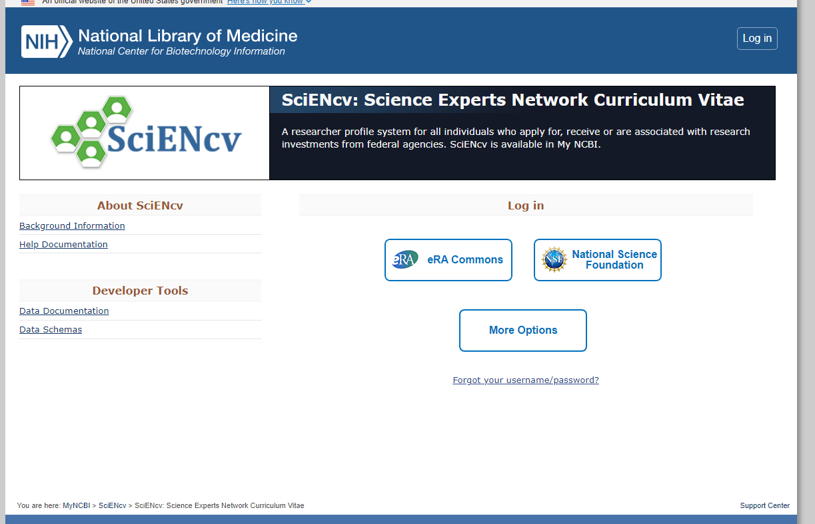
https://www.ncbi.nlm.nih.gov/sciencv/

Slide 3
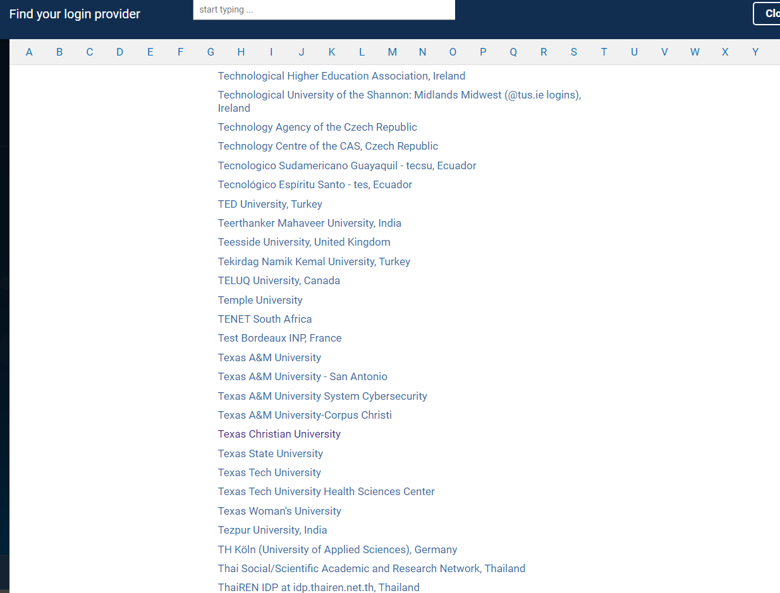
You can use one of the suggested logins or hit more login options and choose Texas Christian University and use your SSO login information.

Slide 4
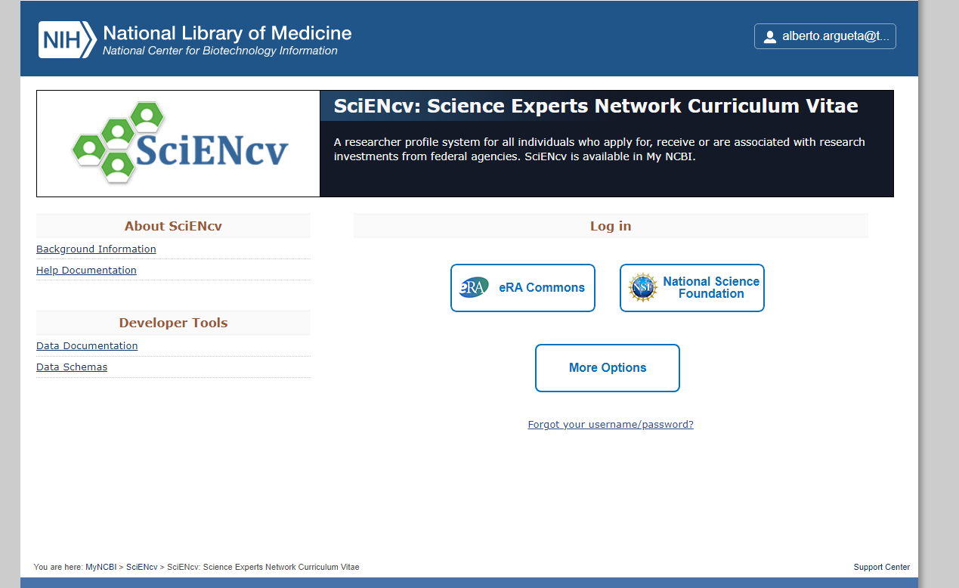
You will come back to this screen which will look identical to the first screen, but you will notice your email on the top right corner indicating you are now logged in.

Slide 5
You will click on your email and a small options menu will open. Click on Account settings.

Slide 6
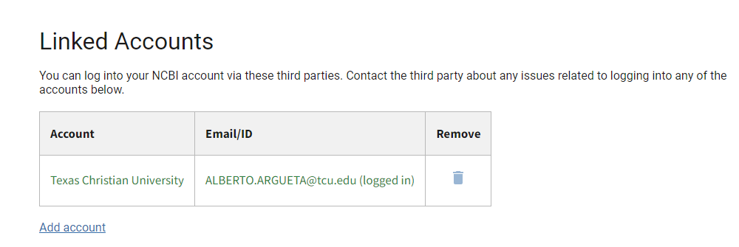
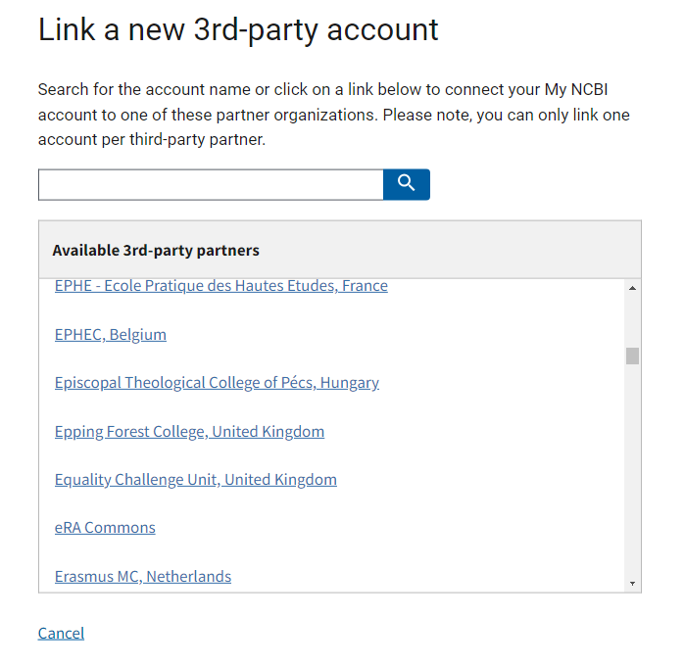
Set up your profile and link any applicable accounts such as NIH, ORCiD, eRA Commons, PubMed, etc. Research.gov and Fastlane have validations built in for the PDF Template or the SciENcv template, so please link you accounts. We STRONGLY discourage the use of delegates.

Slide 7
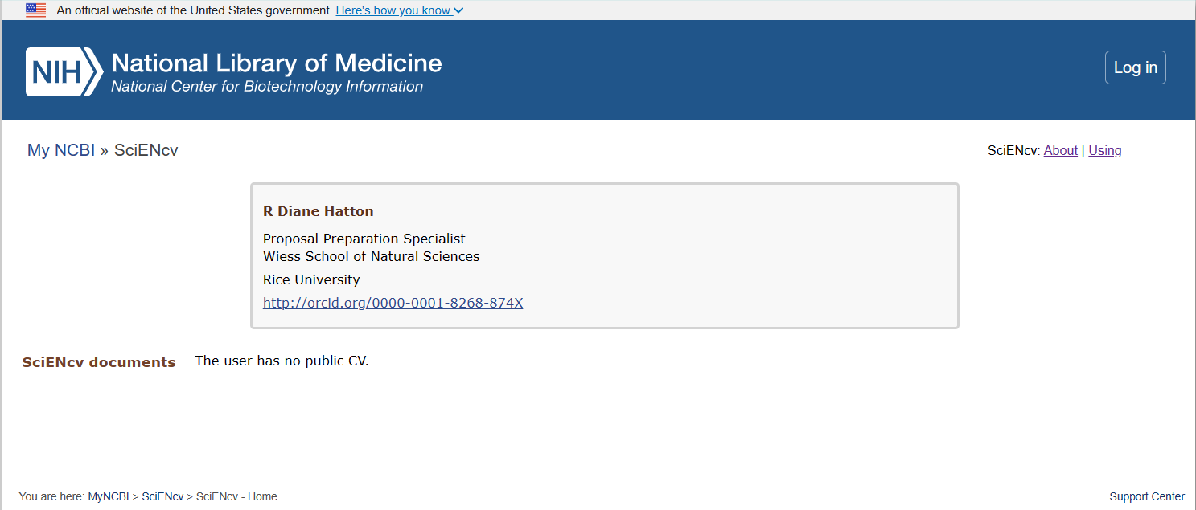
If you do not link any accounts, then some information may not pull as needed from the other websites.

Slide 8
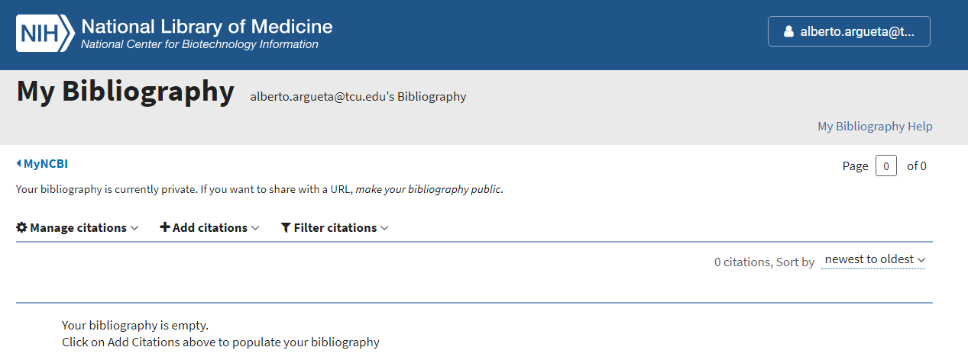
To get started on creating your bibliography click on “My Bibliography”

Slide 9
There are four ways to add publications: *ORCID link (if you link your ORCID account the publications you already have in ORCID will automatically pull into SciENcv) *PubMed *File Import *Manually

Slide 10
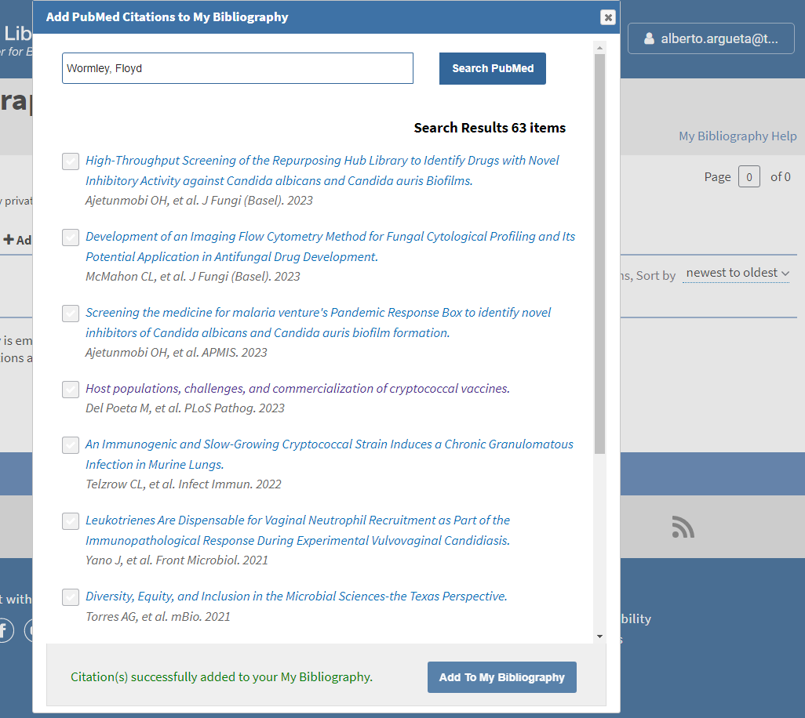
To add from PubMed you click on “+Add Citation” > ‘From PubMed”. You will then search your name (PI), click on the box of your publications, and hit “add to my bibliography.” At the bottom in green, you should get alert that the citations were successfully added.

Slide 11
To add from File you click on “+Add Citation” > ‘From File Import”. Note: you will have to first export the citation as a RIS file.

Slide 12
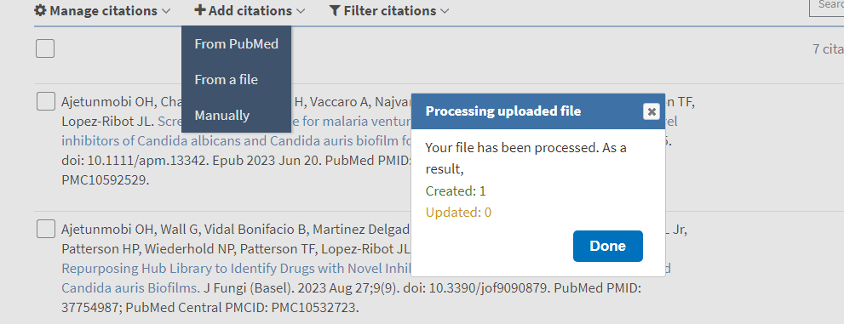
You can now add the RIS file from your downloads.

Slide 13
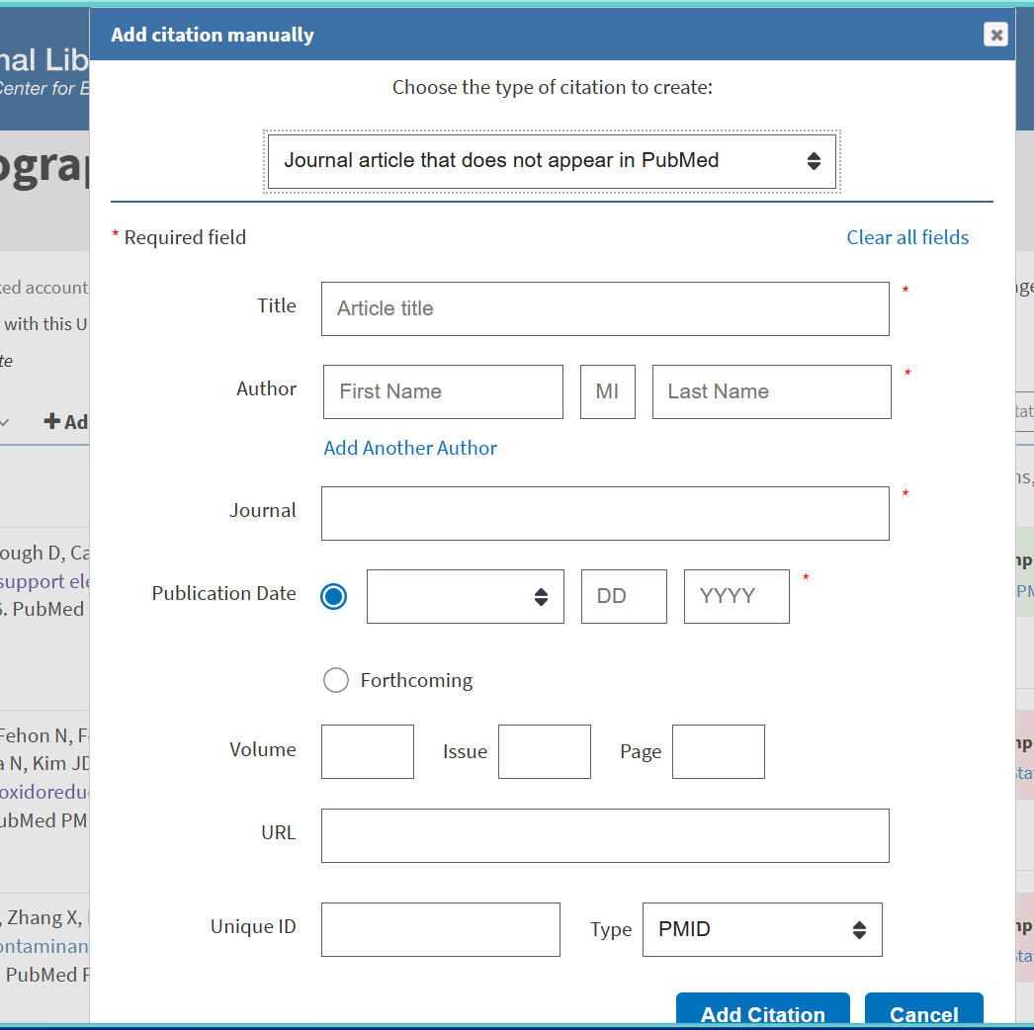
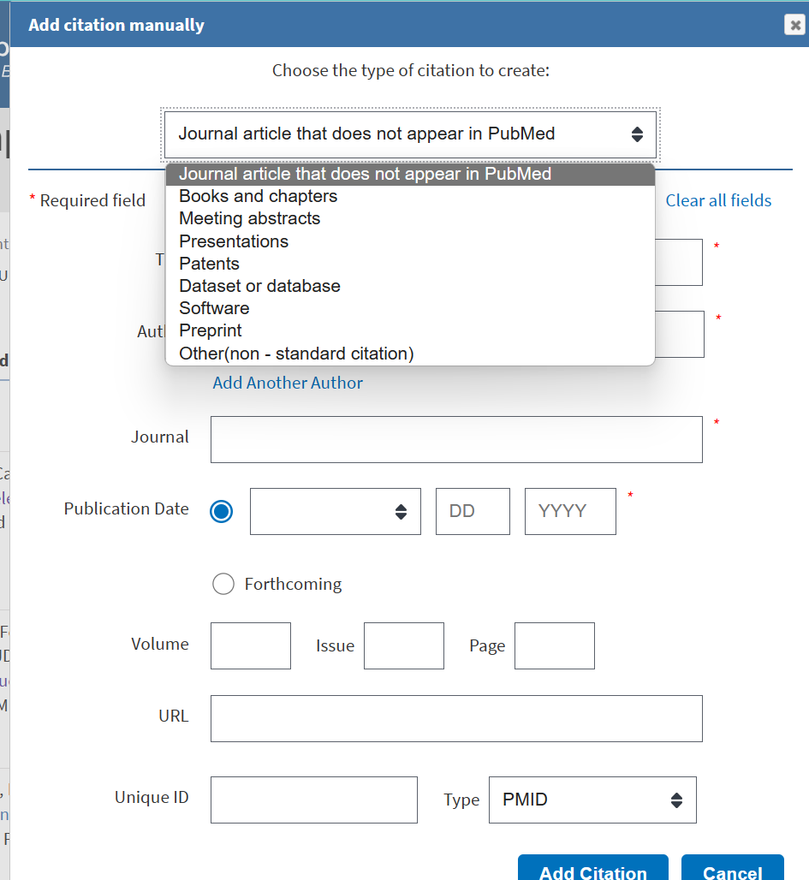
To add Manually you click on “+Add Citation” > ‘Add Manually”.

Slide 14
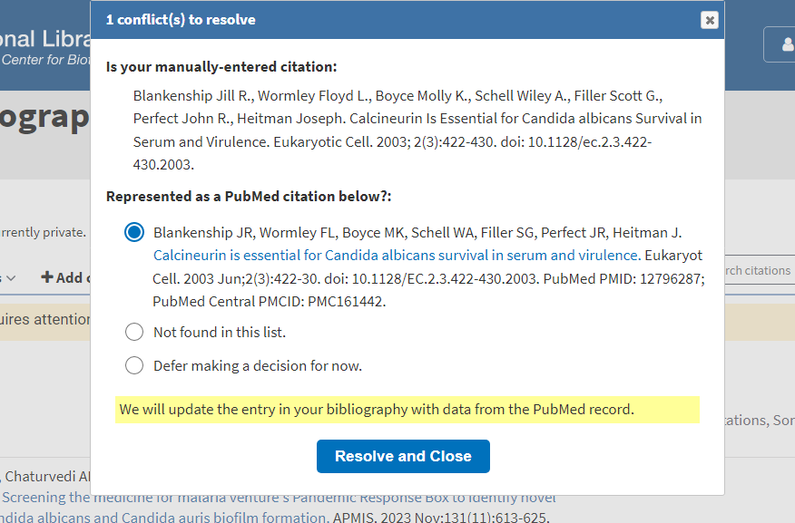
When entering Manual citations or importing RIS citations sometimes you will be asked to resolve a conflict. It could be that the publication is already in your list or that entered/uploaded citation was formatted incorrectly or the format is outdated. Review and move forward to the best of your judgement.

Slide 15
We are now ready to start creating forms. You will go to your dashboard to get started.

Slide 16
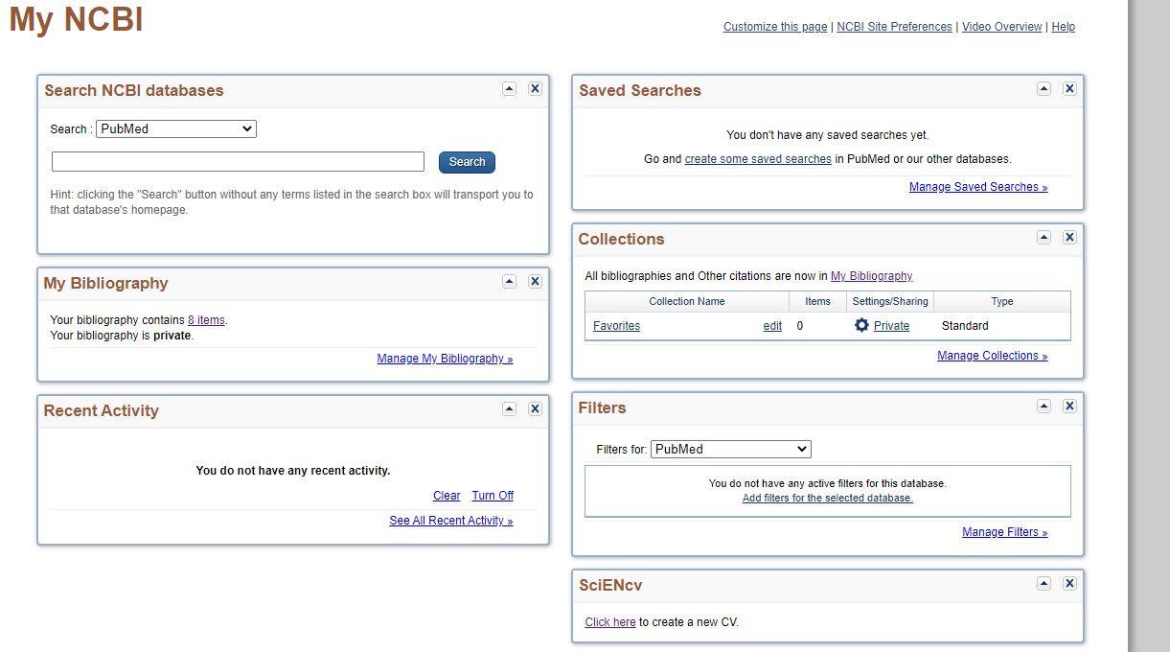
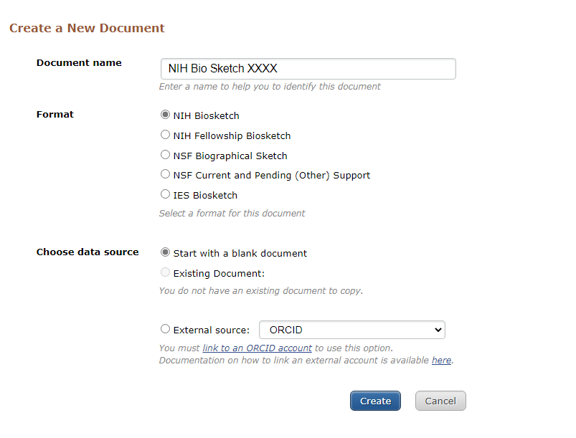
Click on “click here” under the SciENcv
The layout of the upcoming slides might look different depending on your choice of format
Enter the document name, we recommend you include whether the Biosketch is for NIH or NSF so you can reuse it if needed.
Select the format to match your proposal/sponsor.
If you have an existing Biosketch you can select existing document and edit as necessary. (strongly recommend you only use a previously existing NSF Biosketch if you are doing another NSF Biosketch, or an NIH Biosketch if you are creating a new NIH Biosketch.)
If you do not have a previously created Biosketch you want to use as a base then start with a black document.
If you link to ORCID, NSF, or eraCommons then your background information should pull automatically

Slide 17
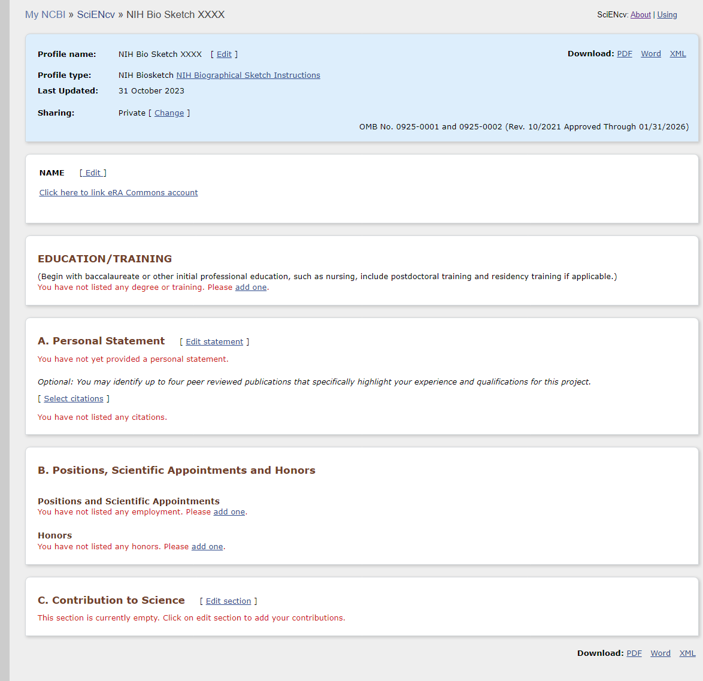
If you do not link your accounts, then you will have to go in manually and add that information.

Slide 18
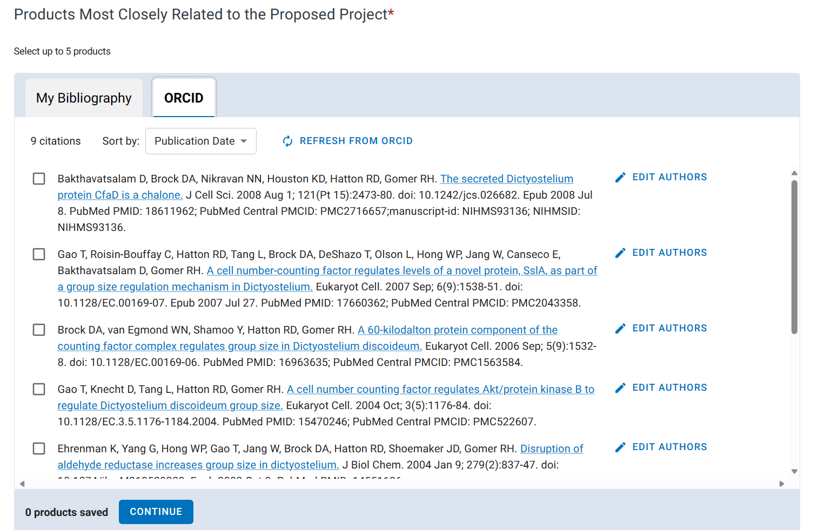

Slide 19
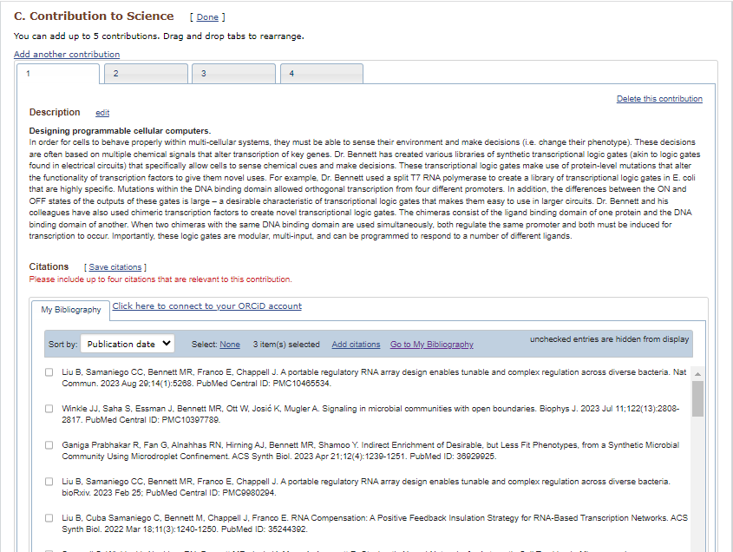

Slide 20
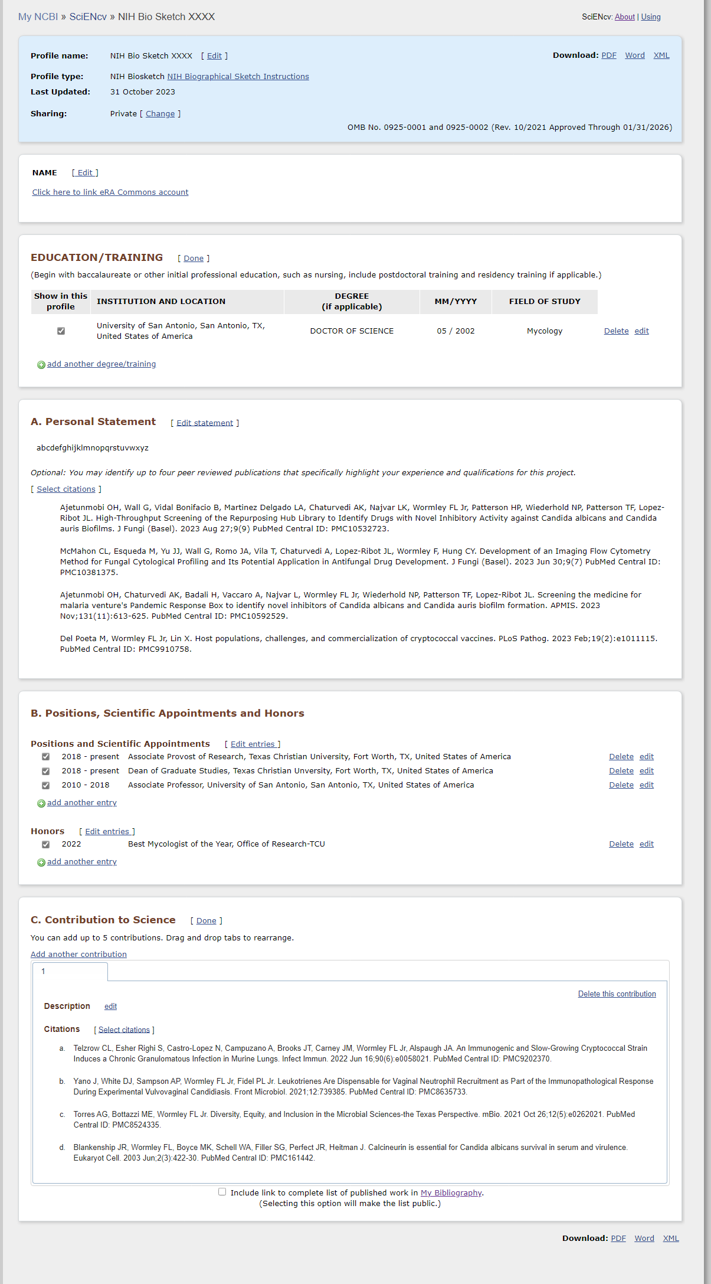
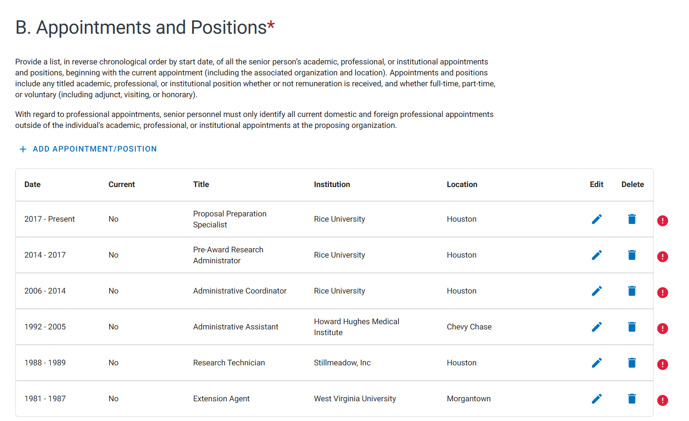
Review information before downloading to ensure all information is accurate and you have selected the publications you wish to showcase. To make changes or updates, do so via SciENcv by editing your Biosketch to make the changes. Do NOT edit the downloaded PDF. Go ahead and download via PDF

Slide 21
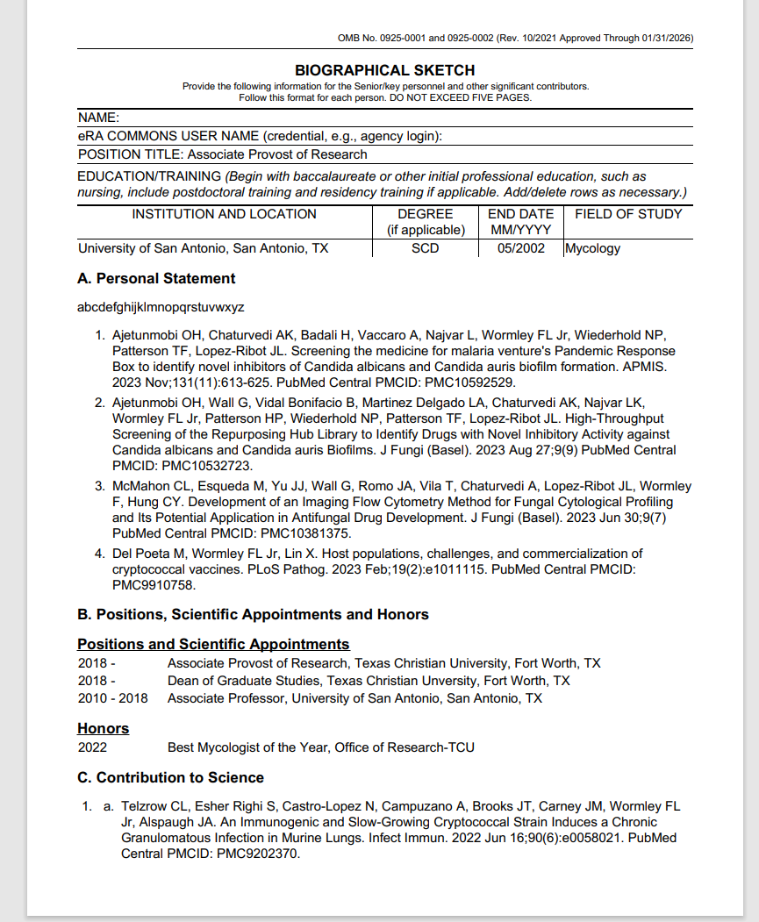
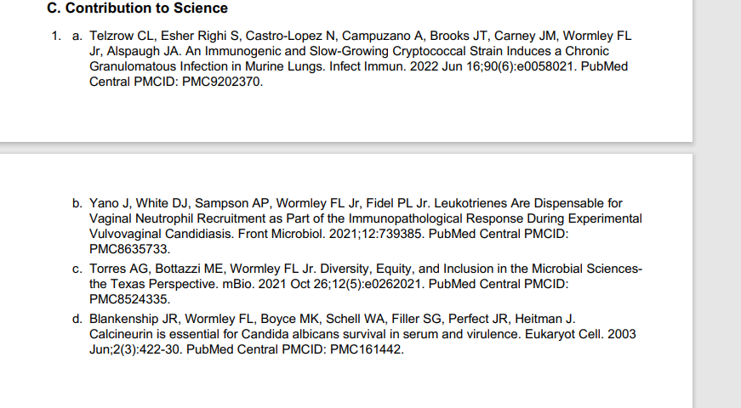
Remember that no other form or document can be used for NSF

Slide 22
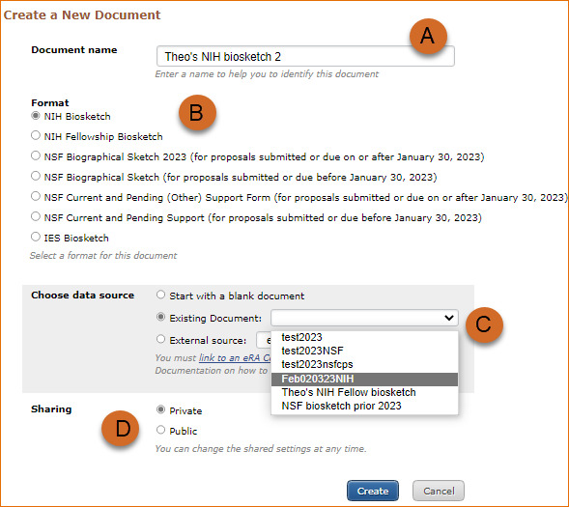
You can also make a duplicate of an existing biosketch. Only make an NIH biosketch using an existing NIH biosketch, and only make an NSF biosketch using an existing NSF biosketch. Use the existing Biosketch as a base, and update the necessary citations. Do NOT create a duplicate. Cater each Biosketch to the sponsor’s RFP/Solicitation

Slide 23
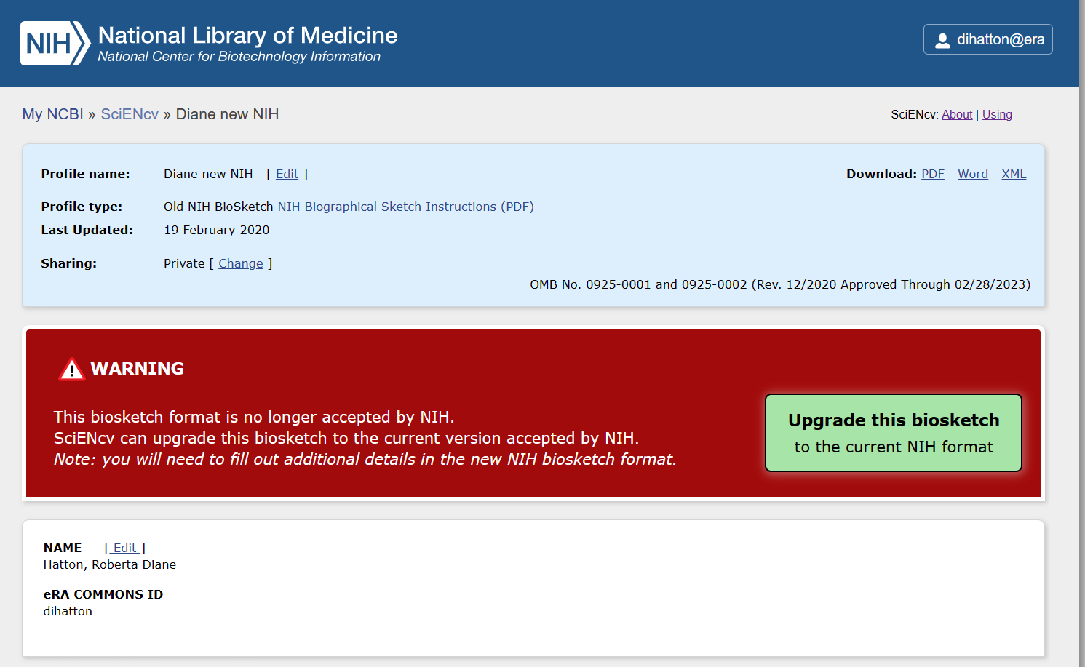
You will sometimes get a warning that the old format of your existing biosketch is outdated and no longer compliant with NIH or NSF. You can click on upgrade to update it to the most current format.

Slide 24
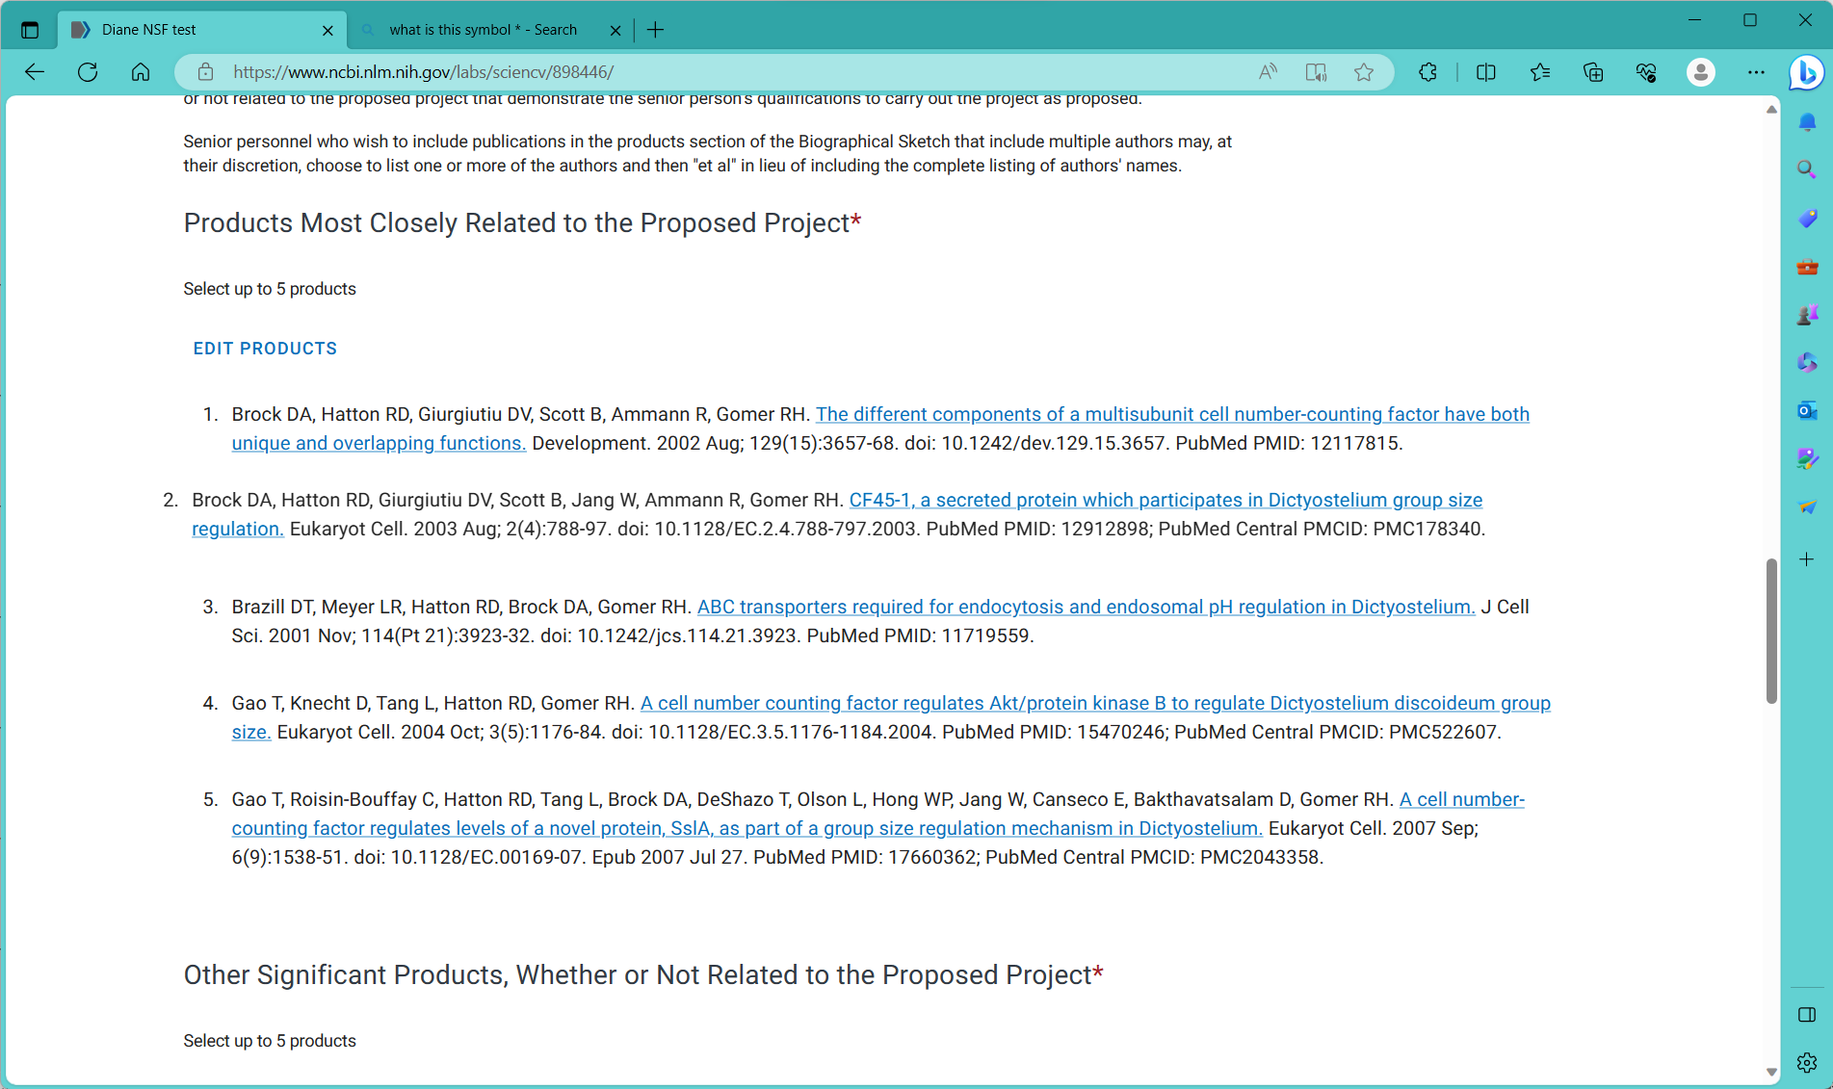
Publications can be rearranged for NSF

Slide 25
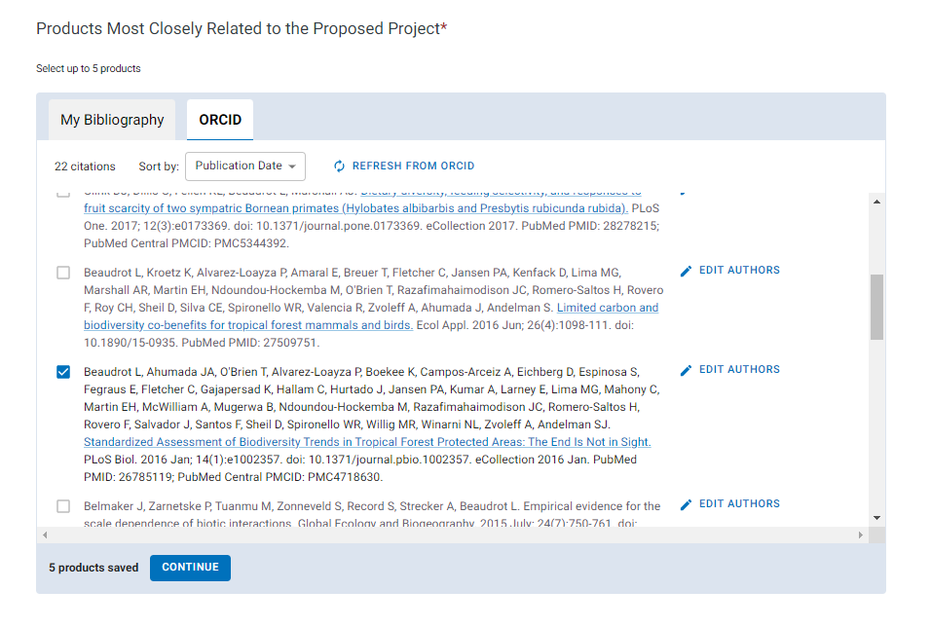
Senior personnel who wish to include publications in the products section of the biographical sketch that include multiple authors may, at their discretion, choose to list one or more of the authors and then "et al" in lieu of including the complete listing of authors' names.

Slide 26
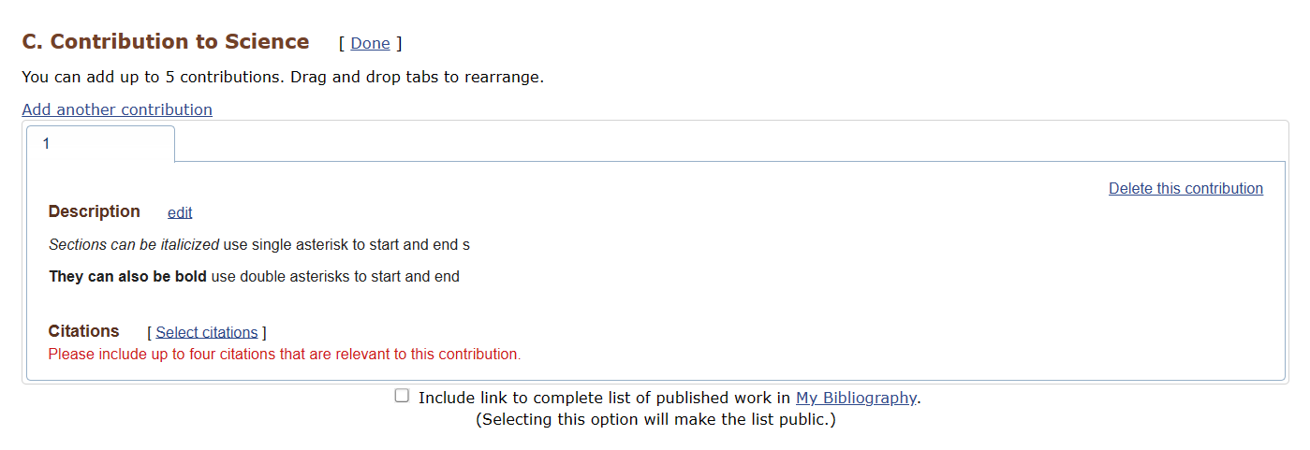
Asterisks can be used to format text in a NIH Biosketch
*text* = Italics **text** = Bold

Slide 27
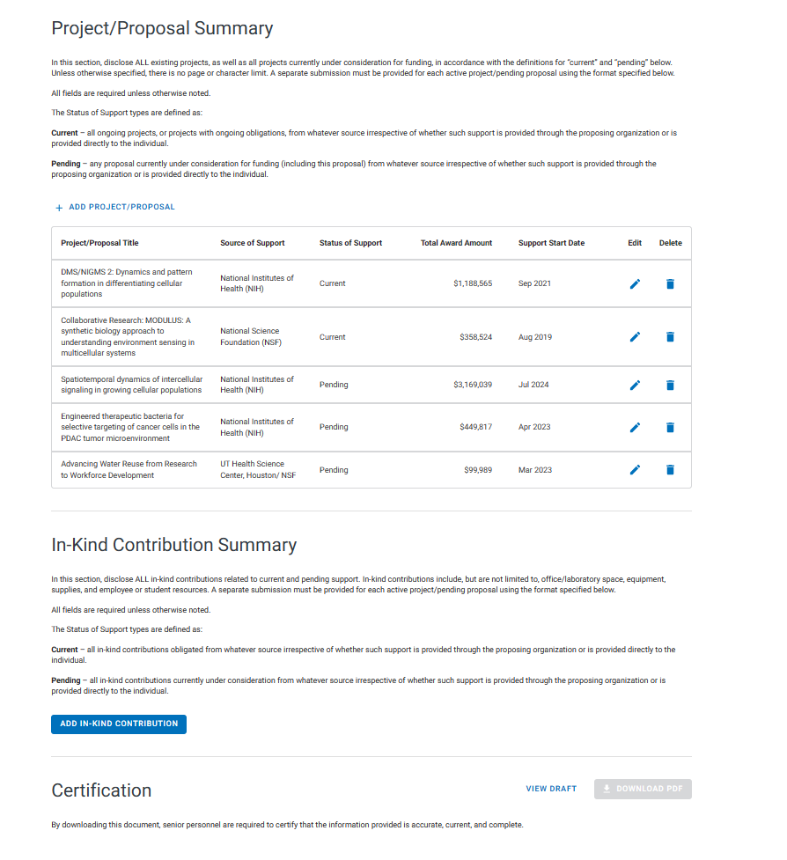
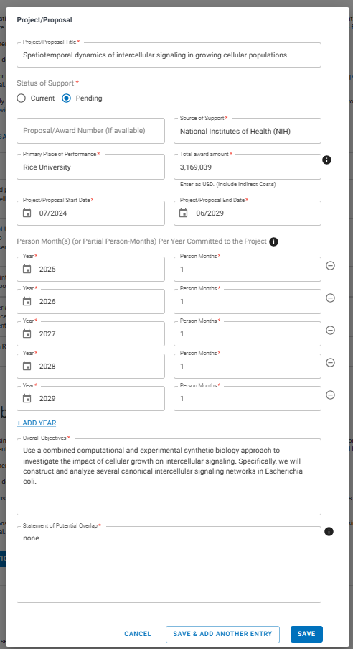
NSF Current and Pending (other) Support

Slide 28
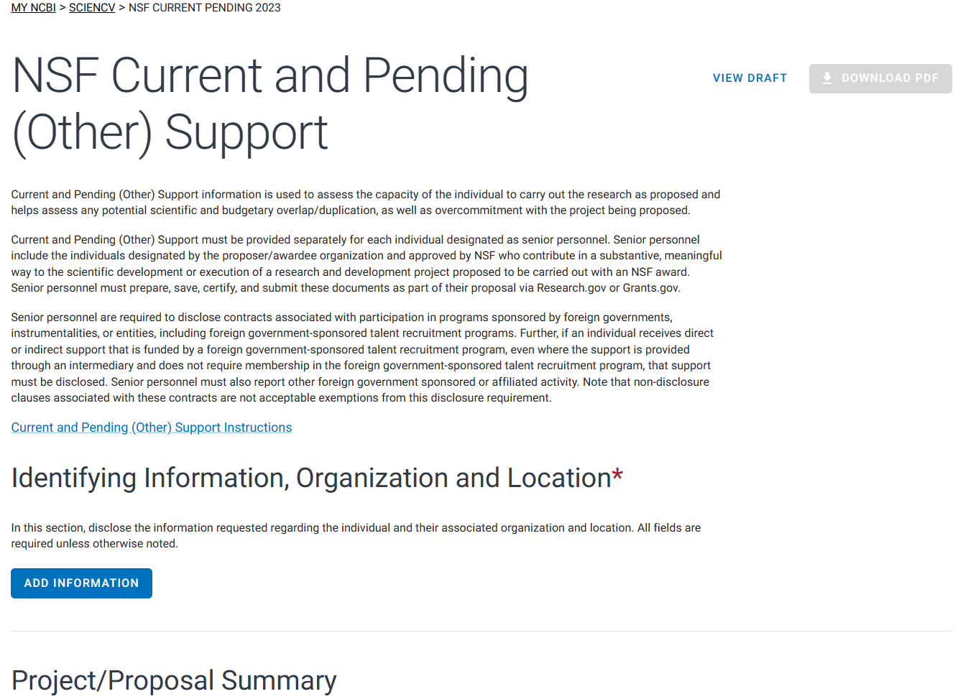
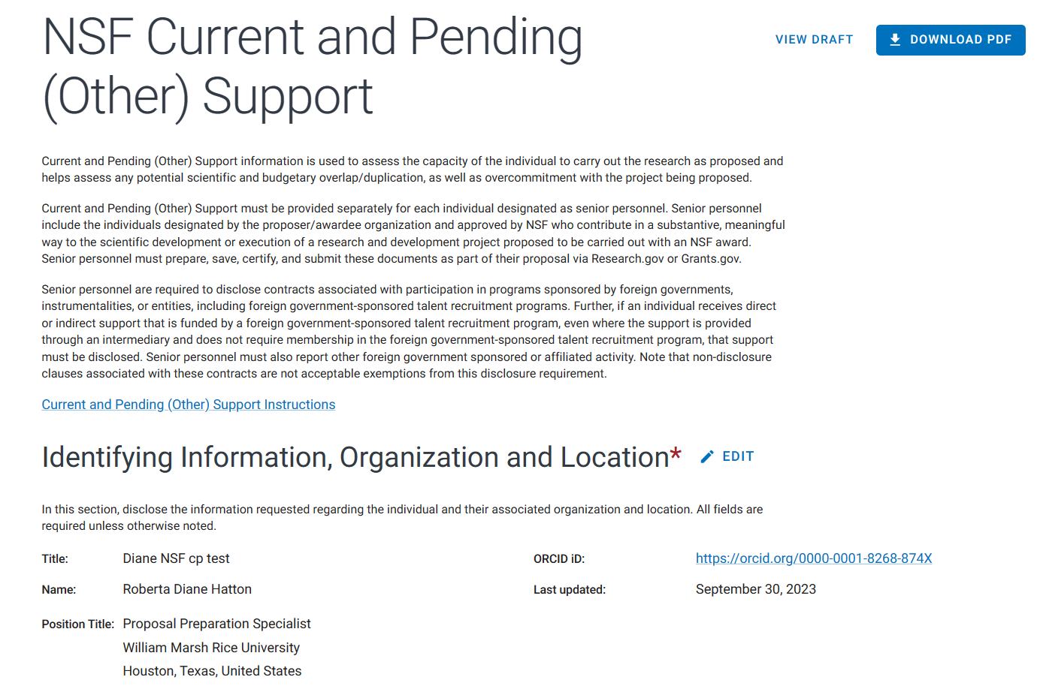
If you are unable to download the PDF you might be missing information.

Slide 29
For further help go to: www.ncbi.nlm.nih.gov/sciencv/help/

