Slide 1
CREATIVE
ACTIVITIES
&

Slide 2
RCAF/JFSRP Proposal
Workshop/
Q & A Session
http://www.research.tcu.edu/

Slide 3
Panelists
Emily Lund
(Chair, RCAF Committee)
LeAnn Forsberg
(Director of Sponsored Programs)

Slide 4
RCAF Committee 2019
Emily Lund, Chair Communication Sciences &Disorders
James Petrovich, Past-Chair Social Work
Amber Esping College of Education
John Harris Philosophy
John Horner Biology
Tricia Jenkins Film, Television, and Digital Media
Alex Lemon English
Jean-Luc Montchamp Chemistry and Biochemistry
Ken Richardson Mathematics
Michael Strausz Political Science
William Wempe Accounting
Jessica Zeller Classical & Contemporary Dance
Floyd Wormley Associate Provost of Research and Interim Dean
of Graduate Studies
LeAnn Forsberg Director Sponsored Research

Slide 5
The RCAF Website
Your go-to resource for all things RCAF/JFSRP
Guidelines
Forms
Example proposals

Slide 6
Eligibility
RCAF: tenure-track, instructors, PPP
JFSRP: Asst. Professor status, must not have college summer funding
(priority to those in first 3 years of tenure track; and those with no prior JFSRP grant funding)

Slide 7
Maximum Awards
RCAF: $4500; faculty salaries not allowed
JFSRP: $6000 summer salary, PI only.
**New this year
Student Mentorship Supplement: $1500

Slide 8
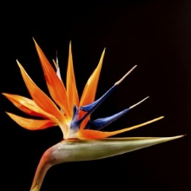
RCAF/JFSRP Awards

Slide 9
RCAF PURPOSE
To provide initial seed money that enables the investigator to do the preliminary work that precedes proposal submission for extramural funding,
To sustain ongoing research for which external funding was sought but not received, and
To support research and creative activities for which external funding is limited

Slide 10
RCAF and JFSRP Use same application

Slide 11
Proposal
Proposal should be organized into four sections:
Grant Application Form (includes Dean/Unit Head signatures)
Project Narrative (Should not exceed 10 pages—Includes: Abstract, Purpose/Goal, Background/Significance/References, Methods/Approach, Professional Development, Record of Scholarly/Creative Activity)
Budget should include Budget Form and one-page budget justification.
Appendices up to 3 appendices – can use an appendix for references and/or to include other supporting information.
Student mentorship supplement – if applying (can add 2 pages to application)

Slide 12
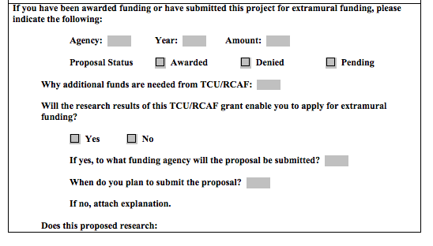

Slide 13
Project Narrative Components
Abstract (200 words)
Provide a summary statement that covers 1) the main point of the project; 2) the problem you intend to solve or question you intend to answer; 3) relevant background; 4) expected methodologies; and 5) intended contributions to the discipline.
Purpose/Goal of Project
In a brief opening paragraph, clearly state the purpose and goals of your project—what do you intend to accomplish and/ produce from this work?

Slide 14
Background, Significance and References
1) Provide an adequate review of pertinent previous work or literature to define how your project fits into the current state of research, knowledge or artistry.
2) Explain why the project is needed. For example, does your project demonstrate a novel approach or new techniques, explores previously unknown source material, fill a major gap in the knowledge base of your discipline, and/or make substantive contributions to or advance the field of study or area of artistry?
3) Provide references/bibliography using a format appropriate for your discipline. Include a list of all references cited in the application and any additional key sources that have informed your main argument.

Slide 15
Method/Approach
What means, procedures, techniques will you use to accomplish your goals (e.g. experimental method, archival data collection, interpretive reading, interviews, surveys, comparative method etc.)? For whatever method you employ, justify your method and explain in detail how you will conduct your investigation or creative activity. Explain how the proposed approach is expected to lead to the achievement of your project goals and what you expect will result from the work. Important: If your work involves animals or human subjects, you must address the ethical and regulatory issues related to your project and whether or not you have obtained IRB and/or IACUC approval. No funds will be distributed without relevant IRB and/or IACUC approval.

Slide 16
Professional Development
Describe how this project will contribute to your scholarship and/or artistic development. For example, the project will:
Enable you to competitively seek external funding to support future work; Will lead to a publication, exhibition, presentation, performance and/or other appropriate scholarly product or creation; and/or Produce specific professional outcomes that are beneficial to your scholarship and/or creative activity.

Slide 17
Record of Scholarly/Artistic Activities
1) Provide a record of your scholarly activities (publications, presentations, performances, exhibitions, external funding) for the previous three to five years. Reviewers expect to see a history of active engagement in artistry, scholarship and/or evidence that experience sufficient for accomplishing this project, whether as a continuation of your current line of inquiry or as a new line of inquiry (this should tie back to your Professional Development section).
2) If you have had prior RCAF/JFSRP support in the past five years, briefly describe the project/s. Does the proposal you are currently submitting tie into earlier support or is it independent of previously supported RCAF/JFSRP projects? If so, how?

Slide 18
Budget and Budget Justification (See Form)
Your budget should be clearly described. Each area of expenditure should be described. If pricing seems out of the ordinary, please explain. Each area of expenditure should clearly relate to the proposed activities and be clearly necessary to those activities. The overall cost of the project should be reasonable. This information goes into the Budget Form, which includes the Budget Spreadsheet and Justification. The budget form does not count against the 10 page maximum.
Appendices (Optional)
You may provide up to three appendices of pertinent supporting materials. These materials should clarify important aspects of the work, but not duplicate the narrative. Do not use to circumvent length restrictions of proposal. Examples of appendices would be such things as survey instruments, letters of collaboration from co-investigators, lengthy budget justifications, copies of catalog pages, or vendor bids, and such.
It is important to write to a general audience.

Slide 19
Student Mentorship Supplement
Financial resources intended to provide students with individualized research mentoring opportunities
The faculty RCAF award ($4500) must not depend on receipt of the student mentorship supplement; that is, it is possible that only the faculty portion will be awarded.
Includes:
Single-page plan that details research/mentoring goals and at least one activity (student + faculty member) that will accomplish each goal
Doesn’t have to be a specific student but can’t support students already receiving fellowships or assistantships
Additional 1-page budget justification for student-related funds
Paying time for work on research
Materials for additional work
Travel expenses for presentations
Travel expenses to visit a collaborator

Slide 20
Example:
Goal: Learn about the research process, research management and qualitative methods
Activity: Add a mixed-methods approach to the XX study. With guidance of XX faculty mentor, I will develop and implement a semi-structured interview for parent participants. [Funds used to purchase gift cards for participants and pay student workers].
Activity: Submit a peer-reviewed journal article. Dr. XX and I will meet weekly to develop a journal article from the data collected by my supplemental project and go through the submission process together.
Goal: Present research findings
Activity: Present a poster at XX conference. Meet weekly with Dr. XX to develop poster and practice presentation in lab meeting. [Funds used for travel].
Activity | Estimated Costs
Research Activity Support | Total Cost: $350 I typically work to support my education 20 hours per week. At $10/hr, this funding would allow me to cut back my work schedule by 5 hours a week for seven weeks of the fall semester to devote extra time solely to data collection and analysis
Present findings at XX convention | Travel to XX: $300 Lodging in XX: $200 Transportation and Meals: $150 Total Cost: $650
Total Budget Estimate | $ 1000

Slide 21
The Evaluation Process

Slide 22
Reviewer Assignments
Proposals assigned to RCAF Committee members to evaluate
Every proposal is reviewed by at least 3 committee members and at least one evaluator is from college or shared area or method – relatable.

Slide 23
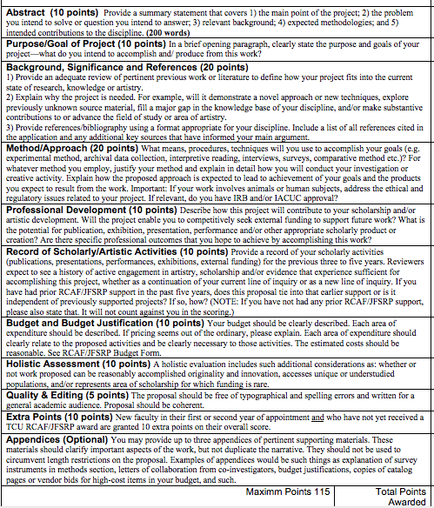
Scoring Process

Slide 24
Scoring:
Abstract (10 points)
Purpose/Goal of Project (10 points)
Background, Significance and References (20 points)
Method/Approach (20 points)
Professional Development (10 points)
Record of Scholarly/Artistic Activities (10 points)
Budget and Budget Justification (10 points)
Holistic Assessment (10 points)
Quality & Editing (5 points)
Extra Points (10 points)
Max Points 115

Slide 25
Tips for Success
Write to a general audience!
READ and FOLLOW the guidelines!
Avoid leaving out required components!
Have someone read over your proposal before submitting-check for errors, readability, clarity etc.

Slide 26
TIPS continued
Make sure each section of the proposal concretely does what it should.
Do not allow sections to ‘blur’.
Specify what you will be using RCAF to fund/purchase etc. Be specific.

Slide 27
DATES
Deadline: January 17, 2019
Committee Meets: ?
Notifications made: Before Spring Break (goal)
http://www.research.tcu.edu/

Slide 28
QUESTIONS??????

