Slide 1
Honoring TCU Fulbright Scholars
Sponsored by the Office of Research

Slide 2
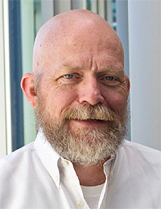
Garry Bruton
Professor, Department of Management
Fulbright-Hall Chair in Entrepreneurship in Emerging Markets, Fulbright Foundation, 2018; 2005

Slide 3
Susan Douglas Roberts
Professor, Dance
Fulbright Specialist: Taipei National University of the Arts, Taipei, Taiwan – 2008
Fulbright Specialist: Centro de Danza e Investigación del Movimiento, Universidad Rafael Landívar, Guatemala, Guatemala - 2011

Slide 4
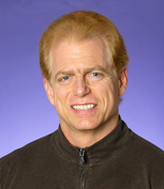
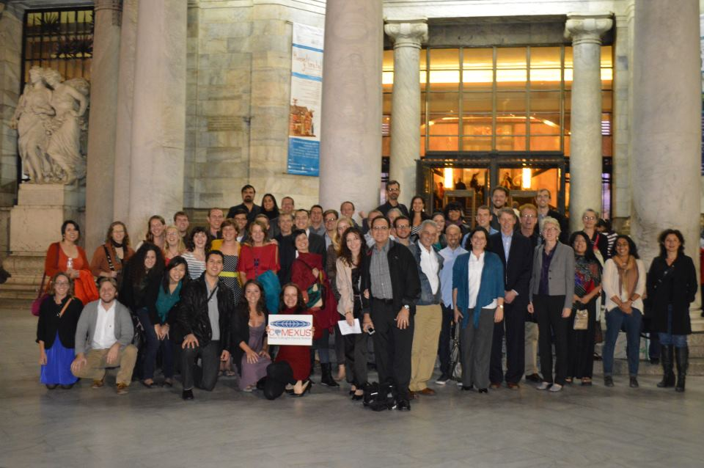
Donald Frischmann
Professor, Department of Spanish and Hispanic Studies
Fulbright-García Robles Research Award at the Universidad Intercultural Maya de Quintana Roo "Tradition and Innovation in Contemporary Yucatec Mayan Literature: The Writers of Quintana Roo State,” Quintana Roo, Mexico 2013
Fulbright-García Robles Research-Teaching Award at the Universidad de las Américas, Puebla, Mexico: "Contemporary Indigenous Literatures of Mexico." Puebla, Mexico 2000-2001

Slide 5
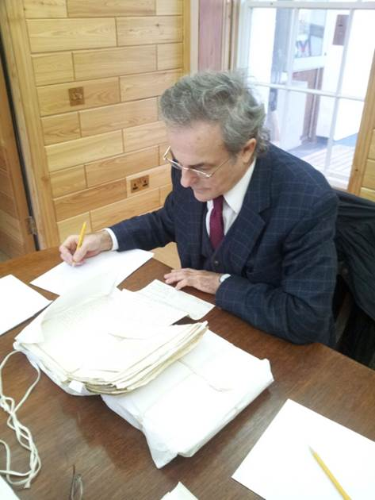
Jack Hill
Professor, Department of Religion
Invited Reviewer, U.S. Fulbright Regional Peer Review Committee, 2016-2017
Fulbright-Scotland Visiting Professorship (Distinguished Chair) at Aberdeen University and Research Fellow, Research Institute of Irish and Scottish Studies, University of Aberdeen, 2013-2014

Slide 6
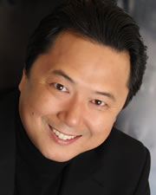
San-Ky Kim
Associate Professor, Voice and Opera
Fulbright Scholar, Vytautas Magnus University Academy of Music, Lithuania, 2015-2016

Slide 7
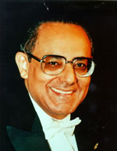
Harold Martina
Pianist-in-Residence, School of Music
Fulbright- Specialist award recipient in Piano, Colombia, 2006

Slide 8
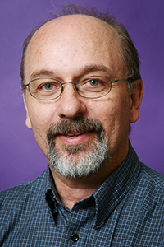
Mauricio Papini
Professor, Department of Psychology
Fulbright-US Scholar, University of Jaen, for project, “Comparative Neuroscience of Emotion and Memory,” 2014-2015

Slide 9
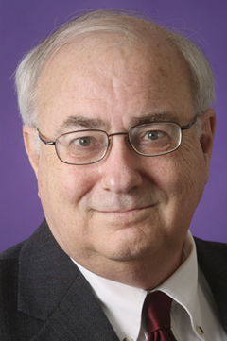
Ken Stevens
Professor, Department of History
Fulbright-US Scholar Distinguished Chair in American Studies at the University of Debrecen, Hungary, Fall 2014

Slide 10
Peter Szok
Professor, Department of History
Fulbright, US Scholar, Panama, for project “Insurgent Beauty: Native American Art in Modern Panama,” 2015-2016
Fulbright, US Scholar, Panama, 2007-2008
Fulbright-Hays Group Project Participant, 2002
Fulbright-Hays Grant, 1993

